Slide 1
INTRODUCTION TO BUSINESS MODELLING
Business model canvasses of:
Procter & Gamble (MNC)
Twitter (Start-up)
-SAKSHI SHETTY

Slide 2
PROCTER & GAMBLE -
A Multinational Company

Slide 3

PROCTER & GAMBLE is an American multinational company that provides consumer products in the areas of cleaning supplies, personal care, pharmaceuticals and pet supplies. Before the sale of Pringles to the Kellogg Company, its product portfolio also included foods, snacks, and beverages.
This company was established in 1837 and has since been growing at a ginormous rate. It began its international expansion outside of the United States in the early 1930s.

Slide 4
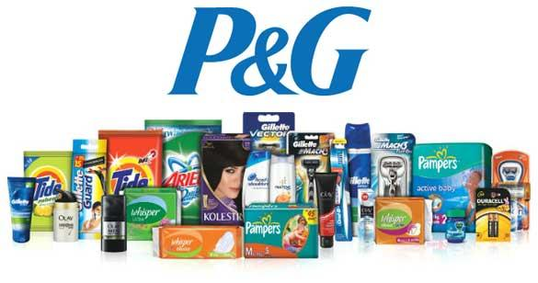
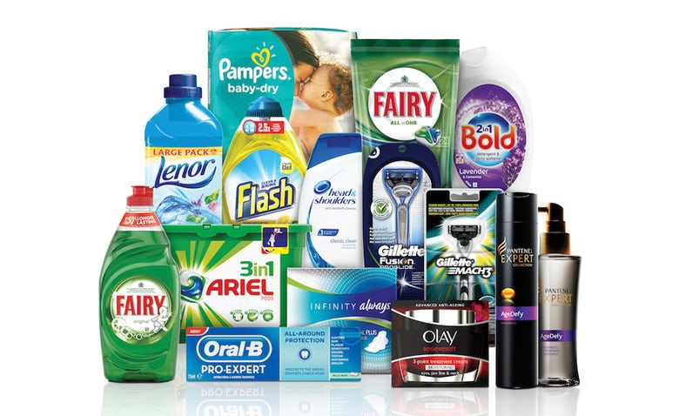

Slide 5
VALUE PROPOSITIONS
Procter and Gamble’s broad range of high quality products, and its reliable supply chain and distribution operations, also create value for its retail and distribution customers in the form of revenue and sales.
Qualitatively: The company ensures availability of products serving a variety of purposes for daily needs - ranging from products required for cleaning to medicines.
Quantitatively: The company’s target is middle-class and upper middle-class population and the products are hence affordable for all.

Slide 6
CHANNELS
P&G serves and distributes through various channels:
Supplying retailers
Chain supermarkets like Walmart, Target etc
Smaller grocery outlets
Online shopping websites like Amazon
Their own official website, www.pgshop.com

Slide 7
CUSTOMER SEGMENTS
All the common household brands whose products we use daily - Oral-B, Gillette, Vicks, Pantene - belong to P&G. Their customer segments, thus, include: Personal hygiene and grooming; Home and fabric care; Feminine and family care; Beauty; Pharmaceuticals. Based on standard customer segments:
Demographic: based on gender, P&G has an entire section of beauty and feminine products - Pantene for instance - for women, shaving creams and the like - Gilette, for instance - for men, as well as unisex brands like Head & Shoulders.
Geographic: based on the economic situation of a particular country, the price range and type of products are different. For example, sanitary napkins are made as cheap as possible in India.
Psychographic: based on the social class of the citizens; higher and and low end products.
Behavioral: based on changing trends and demands of the citizens of a country at that particular period of time.

Slide 8
CUSTOMER RELATIONSHIPS
Customers purchase the Company’s products through third-party retailers or via its self-service online store. The Company’s network of retail customers must deal directly with members of the Procter and Gamble sales and marketing team, or deal indirectly with the Company via distributors.
Larger customers, notably Walmart, work closely with the Company on supply chain and distribution operations, while smaller retailers receive products primarily via third-party distributors.
Procter and Gamble also operates social media accounts with Facebook, Twitter, Instagram, YouTube and LinkedIn, and provides email and mail subscription services, through which it can interact directly with its customers.

Slide 9
KEY ACTIVITIES
Procter & Gamble’s key activities include:
Marketing and advertising
Different customer targets based on different customer segments: beauty, healthcare, hygiene etc
Global expansion of the company to reach more countries
Licensing other chain markets to sell their products
Partnerships with chain markets for a two-way benefit for both companies.

Slide 10
REVENUE STREAMS
Procter and Gamble generates revenue through the manufacture and sale of consumer goods to retailers, mass merchandiser and distributors.
Of the Company’s $76.3 billion in revenue in fiscal year 2015, the sale of Fabric Care and Home Care products accounted for 29%, Feminine and Family Care products accounted for 26.5% and Beauty, Hair and Personal Care products accounted for 23.8%.
The remaining revenue was shared relatively evenly amongst its remaining business segments.

Slide 11
TWITTER -
A Start-up Company

Slide 12

TWITTER is an online networking social media platform wherein users broadcast short notes named “tweets”. It’s a platform used for business, political, and simple social purposes by a diverse age group.
Twitter's origins lie in a "daylong brainstorming session" held by board members of the podcasting company Odeo. Jack Dorsey, then an undergraduate student at New York University, introduced the idea of an individual using an SMS service to communicate with a small group. Clearly, it went on expanding from there.

Slide 13
VALUE PROPOSITIONS
Twitter’s purpose is to let its users broadcast their thoughts and opinions to the world.
It can be said, therefore, that it’s a business that aims to provide a platform for political campaigning, commercial advertising, and the like, with advertising being it’s primary sources of revenue generation from the users.

Slide 14
CUSTOMER SEGMENTS
Demographic: has a uniform user-base that is not specifically targeted towards either gender.
Geographic: based on the availability of this network in the region itself, the particular needs of the community in its own region can be satisfied. For instance, the American user-base was under heavy political influence by the 2 competing parties during the 2016 elections.
Psychographic: no specific psychographic targeting; it’s a resources free to use by all.
Behavioral: based on the user’s tweets, his/her personality can be evaluated and ads that come up in their feed will be highly personalised, leading to a higher chance of the product being purchased, which is beneficial for companies that use Twitter as an advertising platform.

Slide 15
CUSTOMER RELATIONSHIPS
Twitter is a multi-faceted platform that keeps relations with a diverse group of individuals and organisations. Governmental organisations and political parties use it for broadcasting their ideologies and highlighting the flaws in their rivals; often times, it is a relaxed platform used for lighthearted exchanges between users across the globe. It essentially provides a platform for users to connect globally so that even while sitting at home, by simply typing a few words, they can connect with millions of people in an instant.

Slide 16
KEY ACTIVITIES
To maintain its financial status and relevance, the key activities of this company are:
Marketing via advertisements for other companies
Partnering with third party companies
Constant development of its software and user interface to add tweaks that make it more in demand - for instance, the character limit of tweets was doubled from 140 to 280.
Ensuring that users get a safe platform to voice their opinions on issues - while ensuring that negative and harmful tweets are curbed and/or banned and blocked.

Slide 17
REVENUE STREAMS
Twitter sells promoted tweets to marketers, and these then appear in users' feeds. The company creates tailored advertising opportunities by using an algorithm to make sure promoted tweets make it into the right users' timelines.
Google and Microsoft's bing pay Twitter to license tweets so that they can include these tweets in their real-time search results.
Another source of income is data-licensing, wherein certain companies are allowed direct access to tweets so that detailed statistics for the company can be developed. For instance, television shows and digital media brands are heavily invested in Twitter data, often promoting live tweeting as a means to gauge interest and response during event coverage or a broadcast.

Slide 18
THANK YOU.

